Slide 1
Azure AI Ecosystem Technical Deep Dive –Day 1
Sashank Pappu
Azure Data & AI Specialist

Slide 2


Sashank Pappu
Azure Data & AI Specialist.
Certified from MIT on ‘Advanced Analytics and Big Data Challenges’. Technology Enthusiast and Data Specialist. Certified Designer in Computer Vision
• Microsoft Certified Power BI Developer. • Microsoft Certified Azure Machine Learning Developer from Microsoft Virtual Academy • Certified on Practical Data Analytics with Microsoft Cortana Intelligence Suite.
9+ years of total experience as Data Specialist and Data Engineer.
Certifications
Experience
Currently working as Independent Consultant on Azure Data & AI and Enterprise Trainer on Azure Data Analytics , Cortana Intelligence Suite and Cognitive Sciences
Expert facilitator and corporate behavioral trainer with 5 years of experience in designing programs, content development , Data Analytics and Machine Learning.
Role
Training
Sri Nag Sashank
You can see me on – Sashankpappu.com

Slide 3
Day 1 - AI
Azure AI Ecosystem
Azure AML Studio
Azure ML Services
Azure AutoML

Slide 4
Day 2 - AI
Azure Databricks
Azure Machine Learning Services
Deployment into Containers
Use case on Custom AI & Cognitive Services

Slide 5
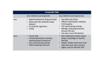
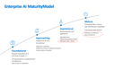
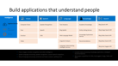
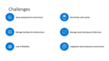
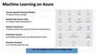


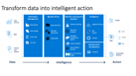
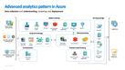
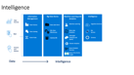
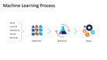
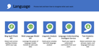
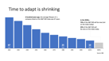




Slide 6
AGENDA
Overview of Machine Learning Offerings
10-11 : AML Studio Intro & Hands on Deployment
11-11:15: BREAK!!!
11:15-1 : AML Studio - Labs Hyper Tuning
1-2 : LUNCH
2-3:15 : Auto ML Intro
3:15-5 : Hands on Azure AutoML

Slide 7

Insights is a journey
Insight
What happened?
Why did it happen?
What will happen?
What should I do?
Reports
Interactive
Dashboards
Predictive
Models
Recommendations
& Automation
Notes:
While data is pervasive, actionable intelligence from data is elusive. We understand that customers want to transform data to intelligent action and reinvent their business processes. To do this they need to more easily analyze massive amounts of data – so they can move from seeing “what happened” and understanding “why it happened” to predicting “what will happen” and ultimately, knowing “what should I do”. Only then can they create the intelligent enterprise and accelerate digital transformation.
Put another way, the journey to greater insight involves moving from “forensic” or “descriptive” analytics – use of historic measurement to describe what happened and why – to more advanced analytics that become “predictive” and eventually “prescriptive”.
This journey is a natural evolution as an organization leverages data more thoroughly. We think about it in 4 steps:
Step 1: What happened?
Utilize descriptive analytics to understand what happened
Step 2: Why did it happen?
Incorporate diagnostic analytics for a better understanding of why certain things happened in the past, making it possible to better identify root causes
Step 3: What will happen?
Expand into predictive analytics: With sufficiently detailed historical data and the rigorous application of statistical methods including machine learning, we can now predict a variety of events and effects that could not accurately be forecast in the past.
Step 4: What should I do?
Use prescriptive analytics for foresight: Foresight is the holy grail of analytics. By analyzing a set of reactions, we can not only predict what will happen, but how various responses will fare, given individual conditions, people, etc. It requires not only that we predict, but that we measure the individualized results of actions taken in the past, like medical treatments for particular patient cohorts, and then measure the effectiveness of past actions in prescribing how to react in the future. We can then automate action based on the prescriptive analytics, delivering business value directly in the flow of daily business activities.

Slide 8
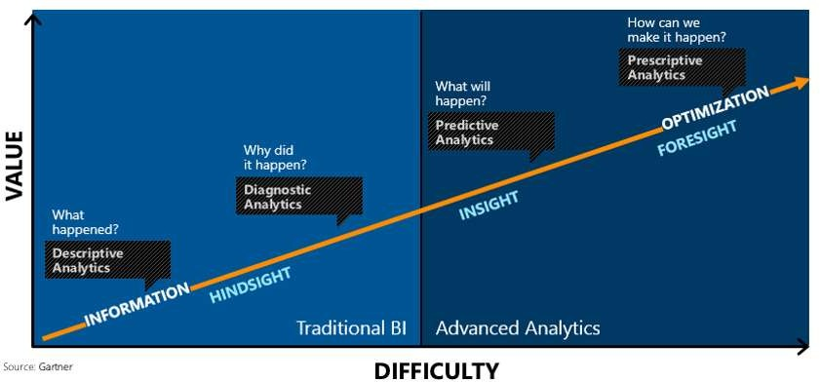

Slide 9




Enterprise AI Maturity Model
Mature
Emerging data science
and operational capability
Understands model lifecycle
Building a foundational data architecture
Aspirational
Experimented and applied AI
High digitization
Desires new business models Achieved a data culture
Approaching
Hopeful on AI and its promise
Digitization underway
Looking to increase or optimize processes Cautious about disruption
Foundational
Questioning what AI is and how to apply it
Wrong expectations or disappointment Low digitization
Basic analytical capabilities

Slide 10
Convergence accelerates digital transformation
Cloud
Data
Intelligence
Notes:
Three key trends are converging to accelerate digital transformation:
First, the cloud provides new and powerful ways to economically and reliably capture and persist the vast new data resources.
Second, thanks to the exponential proliferation of small, inexpensive chips and processors, computers are as ubiquitous as the people who use them. This is increasing the availability of vast and detailed data about products, businesses, market conditions, devices, and consumers and is creating new opportunities for businesses to tailor their strategy to market demand.
Finally, machines are everywhere, constantly creating, collecting and making sense of the data in our midst. With the magic of machine learning, along with the limitless computing power of the cloud, this data is giving rise to intelligence that is augmenting human capabilities in exciting new ways. This marks a unique point in history…an opportunity for organizations to automate and innovate quickly to increase their speed of business.

Slide 11
Time to adapt is shrinking
A hundred years ago, the average lifespan of a company listed on the S&P 500 index was 67 years
In the 2020s…
75% of the S&P 500 will be new (not on the index today)
25% of the S&P 500 will
be ones on the index today
Source: BBC
Notes:
Compared to the past, what’s unique about the disruption happening today is its pace. During past revolutions, firms had many years, even decades, to adapt. Today, that is no longer the case. One indicator of just how fast the landscape is changing is the longevity of companies on the S&P 500, an index of leading US companies.
A hundred years ago, the average lifespan of a company listed on the S&P 500 was 67 years. Today, that average lifespan has decreased to just 15 years.
Experts predict that in the next decade, only 25% of the companies currently listed on the S&P 500 will remain there, and the other 75% will be replaced by new companies.
The bottom line is, today’s organizations must adapt quickly to change, using new technologies that fuel competitive advantage, or risk getting left behind.
-------------------------------------------
Statistics source:
BBC, 2012, quoting Richard Foster - http://www.bbc.com/news/business-16611040
"The average lifespan of a company listed in the S&P 500 index of leading US companies has decreased by more than 50 years in the last century, from 67 years in the 1920s to just 15 years today, according to Professor Richard Foster from Yale University. Professor Foster estimates that by 2020, more than three-quarters of the S&P 500 will be companies that we have not heard of yet."

Slide 12



Information Management
Information Management
Data Sources
Data Factory
Apps
Data Catalog
Event/IoT Hubs
Sensors and devices
Data
Notes:
T: Information Management includes Data Factory, Data Catalog, and Event Hubs.

Slide 13
Big Data Stores
Information Management
Big Data Stores
Data Sources
Data Factory
Data Lake Store
Data Catalog
SQL Data
Warehouse
Apps
Event Hubs
{ }
Cosmos DB
Sensors and devices
Data
Notes:
T: Azure provides a variety of storage options, including Blobs. Here we’ll dive into the two main storage options with Cortana Intelligence, starting with Data Lake Store.

Slide 14

Machine Learning and Analytics
Information Management
Big Data Stores
Machine Learning and Analytics
Data Sources
Data Factory
Data Lake Store
Machine Learning
Data Catalog
SQL Data
Warehouse
Data Lake Analytics
Apps
HDInsight
(Hadoop and Spark)
Event Hubs
{ }
Cosmos DB
Stream Analytics
Sensors and devices
Azure Analysis Services
Azure Time Series Insight
Data
Intelligence
Notes:
T: Advanced analytics services are where data starts turning into insight that drives intelligent action.

Slide 15
Intelligence
Information Management
Big Data Stores
Machine Learning and Analytics
Intelligence
Data Sources
Data Factory
Data Lake Store
Machine Learning
Cognitive Services
Data Catalog
SQL Data
Warehouse
Data Lake Analytics
Bot Service
Apps
HDInsight
(Hadoop and Spark)
Event Hubs
{ }
Cosmos DB
Cortana
Stream Analytics
Sensors and devices
Azure Analysis Services
Azure Time Series Insight
Data
Intelligence
Notes:
T: Our intelligence capabilities fall into three areas – Cognitive Services, Bot Framework and Cortana.

Slide 16


Build applications that understand people
Intelligence
Vision
Speech
Language
Knowledge
Search
Cognitive Services
Computer Vision
Speaker Recognition
Text Analytics
Academic
Bing Web Search API
Content Moderator
Bing Speech
Bing Spell Check
Entity Linking
Bing Image Search API
Bot Service
Face
Custom Speech Service
Web Language Model
Knowledge Exploration
Bing Video Search API
Cortana
Emotion
Linguistic Analysis
Recommendations
Bing News Search API
Video
Language Understanding
QnA Maker
Bing Auto Suggest API
Translator
Faces, images, emotion recognition and video intelligence
Spoken language processing, speaker recognition, custom speech recognition
Natural language processing, sentiment and topics analysis, spelling errors
Complex tasks processing, knowledge exploration, intelligent recommendations
Bing engine capabilities for Web, Autosuggest, Image, Video and News
Notes:
What’s incredibly unique is the intelligence capabilities Cortana Intelligence offers, building on years of Microsoft research and innovation. These capabilities enable our customers to build intelligent systems and agents that can augment their organizational capabilities. For example, organizations can interact with customers and stakeholders in new ways and infer intent with vision, face, speech, text and sentiment analysis to customize responses and drive appropriate actions.
Microsoft Cognitive Services, a set of cloud services, APIs and SDKs that enable organizations to build intelligent systems that can see, hear, interpret and understand the world around you and makes all applications more intelligent, engaging and discoverable. Cognitive Services expands the existing perceptual intelligence capabilities like Vision, Speech, Text and Face detection to include new cognitive capabilities such as Emotion and customized Language Understanding. What we showcased with www.how-old.net is one example of what is possible.
T: Next, Bot Service.

Slide 17

Transform data into intelligent action
Information Management
Big Data Stores
Machine Learning and Analytics
Intelligence
Data Sources
People
Data Factory
Data Lake Store
Machine Learning
Cognitive Services
Data Catalog
SQL Data
Warehouse
Data Lake Analytics
Bot Service
Apps
Web
Event Hubs
HDInsight
(Hadoop and Spark)
{ }
Cosmos DB
Cortana
Mobile
Apps
IoT Hubs
Stream Analytics
Dashboards & Visualizations
Bots
Sensors and devices
Azure Analysis Services
Azure Time Series Insight
Power BI
Automated Systems
Data
Intelligence
Action
Notes:
T: Cortana Intelligence provides everything you need to transform your organization’s data into intelligent action. Next, let’s take a look at another demo.

Slide 18
AI is new SQL
Trends and Advancements in space of Computer Vision and NLP

Slide 19
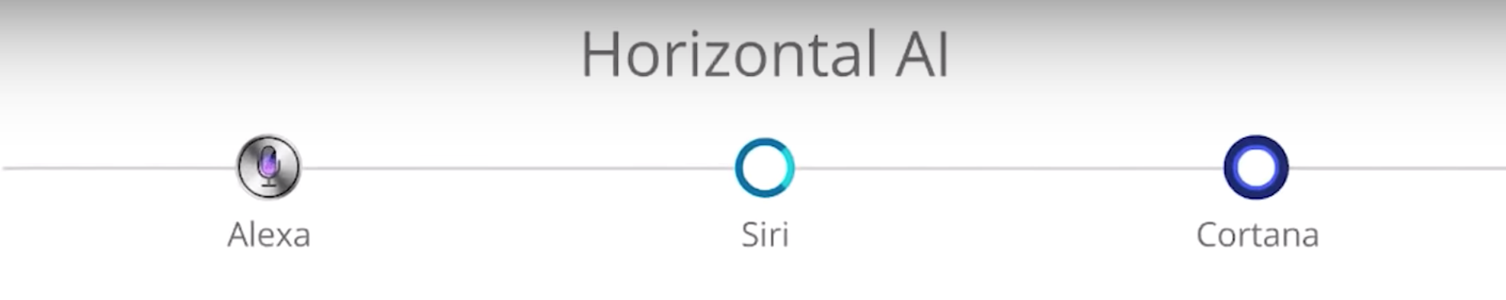
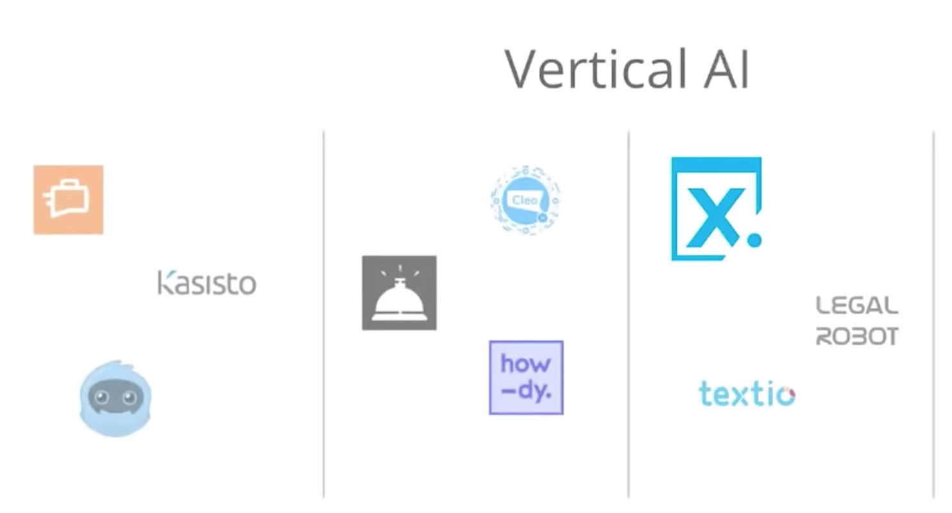

Slide 20
AI-driven development

Slide 21
AI Services
AI-driven development looks at tools, technologies and best practices for embedding AI into applications and using AI
AI infrastructure, AI frameworks ,AI platforms , AI Services
“Technology and thinking will shift to a point where the experience will connect people with hundreds of edge devices”

Slide 22
“By 2020, more than 40% of data science tasks will be automated”
What does it mean to us ?

Slide 23




Build applications that understand people
Intelligence
Vision
Speech
Language
Knowledge
Search
Cognitive Services
Computer Vision
Speaker Recognition
Text Analytics
Academic Knowledge
Bing Search API
Bot Framework
Face
Speech
Bing Speller
Entity Linking Service
Bing Image Search API
Cortana
Emotion
CRIS
Web Language Model
Knowledge Exploration Service
Bing Video Search API
Video
Linguistic Analysis
Recommendations
Bing News Search API
Language Understanding Intelligent Service
Bing Auto Suggest API
Faces, images, emotion recognition and video intelligence
Spoken language processing, speaker recognition, custom speech recognition
Natural language processing, sentiment and topics analysis, spelling errors
Complex tasks processing, knowledge exploration, intelligent recommendations
Bing engine capabilities for Web, Autosuggest, Image, Video and News
Notes:
What’s incredibly unique is the intelligence capabilities Cortana Intelligence offers, building on years of Microsoft research and innovation. These capabilities enable our customers to build intelligent systems and agents that can augment their organizational capabilities. For example, organizations can interact with customers and stakeholders in new ways and infer intent with vision, face, speech, text and sentiment analysis to customize responses and drive appropriate actions.
Microsoft Cognitive Services, a set of cloud services, APIs and SDKs that enable organizations to build intelligent systems that can see, hear, interpret and understand the world around you and makes all applications more intelligent, engaging and discoverable. Cognitive Services expands the existing perceptual intelligence capabilities like Vision, Speech, Text and Face detection to include new cognitive capabilities such as Emotion and customized Language Understanding. What we showcased with www.how-old.net is one example of what is possible.
Why choose these APIs? They work, and it’s easy.
Easy: The APIs are easy to implement because of the simple REST calls. Being REST APIs, there’s a common way to implement and you can get started with all of them for free simply by going to one place, one website, www.microsoft.com/cognitive. (You don’t have to hunt around to different places.)
Flexible: We’ve got a breadth of intelligence and knowledge APIs so developers will be able to find what intelligence feature they need; and importantly, they all work on whatever language, framework, or platform developers choose. So, devs can integrated into their apps—iOS, Android, Windows—using their own tools they know and love (such as python or node.js, etc.).
Tested: Tap into an ever-growing collection of powerful AI algorithms developed by experts. Developers can trust the quality and expertise build into each API by experts in their field from Microsoft’s Research organization, Bing, and Azure machine learning and these capabilities are used across many Microsoft first party products such as Cortana, Bing and Skype.
T: Next, Bot Frameworks.

Slide 24
Vision
From faces to feelings, allow your apps to understand images and video
Computer Vision API
Face API
Emotion API
Video API
Distill actionable information from images
Detect, identify, analyze, organize, and tag faces in photos
Personalize experiences with emotion recognition
Analyze, edit, and process videos within your app
Notes:
Vision
Computer Vision API: as a free trial on the website microsoft.com/cognitive. There are also SDKs and Samples available on GitHub or through NuGet, Maven, and Cocoapods for select platforms to make development easier. It’s important to note here that it’s not client side running code, but light wrappers around the REST calls to make integration easy.
A photo app would use this as a way to tag user photos and make it easier for users to search through their collections. An assistive app would use this as a way to describe the surroundings to visually-impaired users. Works really well on both indoor or outdoor images; it can recognize common household objects, and it can describe outdoor scenes. However, we did not train on aerial images (say from drones), or on many close ups (so pictures where we zoomed in extremely on the subject won't do well). We also do really well recognizing celebrities (as long as most of the face is visible, and they were facing the camera).
Face API: Some potential uses for this technology include facial login, photo tagging, and home monitoring. Or attribute detection to know age, gender, facial hair, etc.
Emotion API: is available in the Azure marketplace, as a free trial on the website microsoft.com/cognitive. See Computer Vision description.
Build an app that responds to moods. Using facial expressions, this cloud-based API can detect happiness, neutrality, sadness, contempt, anger, disgust, fear, and surprise. The AI understands these emotions based on universal facial expressions, and it functions cross-culturally, so your app will work around the world. Some use cases would be an advertising company wants to test user response to an ad, a tv studio wants to track responses to a pilot.
Video API: as a free trial on the website microsoft.com/cognitive. See Computer Vision description.
It brings Microsoft state of the art video processing algorithms to developers. With Video API, developers can analyze and automatically edit videos, including stabilize videos, create motion thumbnails, track faces, and detect motion. Use cases: For Stabilization: If you have multiple action videos, you can use the stabilization algorithm to make them less shaky and easier to watch. You can also use the stabilization algorithm as a first step in performing other video APIs. For Face Tracking: You can track faces in a video to do A/B testing in a retail setting. You can combine Video API Face Tracking with capabilities in Face API to search through surveillance, crime, or media footage to look for certain person. For Motion Detection: Instead of having to watch long clips of surveillance footage, the API will let you know what time motion occurred and its duration. For Video Thumbnail: Take a long video, such as a keynote presentation, and automatically create a short preview clip of the talk. For Face Tracking: Works best for frontal faces. Currently cannot detect small faces, side or partial faces. For Motion Detection: Detects motion on a stationary background (e.g. fixed camera). Current limitations of the algorithms include night vision videos, semi-transparent objects, and small objects. For Video Thumbnail: Take a long video, such as a keynote presentation, and automatically create a short preview clip of the talk.

Slide 25

Computer Vision APIs
Analyze an image Understand content within an image
OCR Detect and recognize words within an image
Generate thumbnail Scale and crop images, while retaining key content
Recognize Celebrities Thanks to domain specific models, ability to recognize 200K celebrities from business, politics, sports and entertainment around the World.
Notes:
Do you need an API that gives you actionable information about images used in your app? The Computer Vision API gives you the tools to understand the contents of any image. Create tags identifying objects, beings, or actions present in the image, and then craft coherent sentences to describe it. Whether you want to execute better image search, or you want to create an assistive app for the visually impaired, the Computer Vision API helps get the job done.

Slide 26
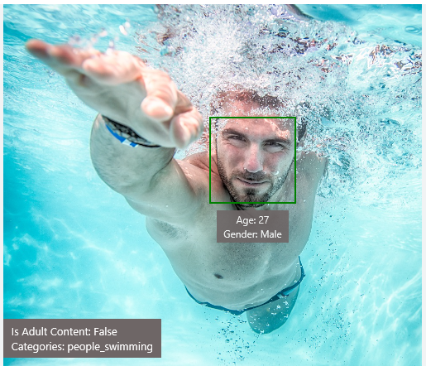
Analyze image
Type of image
Clip Art Type 0 Non-clipart
Line Drawing Type 0 Non-Line Drawing
Black & White Image False
Content of image
Categories [{ “name”: “people_swimming”, “score”: 0.099609375 }]
Adult Content False
Adult Score 0.18533889949321747
Faces [{ “age”: 27, “gender”: “Male”, “faceRectangle”: {“left”: 472, “top”: 258, “width”: 199, “height”: 199}}]
Image colors
Dominant Color Background White
Dominant Color Foreground Grey
Dominant Colors White
Accent Color

Slide 27

OCR
Good at
JSON:
{
"language": "en",
"orientation": "Up",
"regions": [
{
"boundingBox": "41,77,918,440",
"lines": [
{
"boundingBox": "41,77,723,89",
"words": [
{
"boundingBox": "41,102,225,64",
"text": "LIFE"
},
{
"boundingBox": "356,89,94,62",
"text": "IS"
},
{
"boundingBox": "539,77,225,64",
"text": "LIKE"
}
. . .
Scanned documents
Photos with text
Fine grained location information
LIFE IS LIKE
RIDING A BICYCLE
TO KEEP YOUR BALANCE
YOU MUST KEEP MOVING

Slide 28




Smart thumbnail
Smart cropping on
Smart cropping off

Slide 29

Recognize emotions Detect emotions based on facial expressions in photos and videos
Emotion APIs
Notes:
How are you feeling? Can your app tell? With the Emotion API, you can build an app that recognizes emotions according to facial expressions—giving you the capability to provide an amazing, personalized experience.
Using facial expressions, this cloud-based API can detect happiness, neutrality, sadness, contempt, anger, disgust, fear, and surprise. The AI understands these emotions based on universal facial expressions, and it functions cross-culturally, so your app will work around the world.

Slide 30
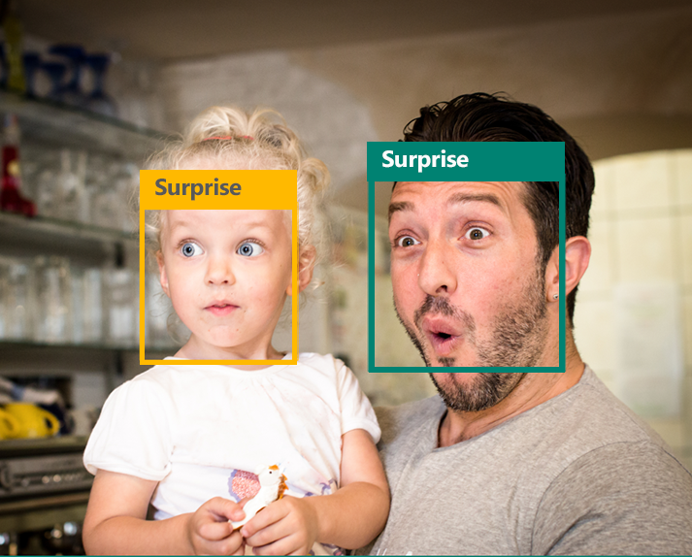
Emotion APIs
Face detection
"faceRectangle": {"width": 193, "height": 193, "left": 326, "top": 204} …
Emotion scores
“scores": { "anger": 5.182241e-8,
"contempt": 0.0000242813,
"disgust": 5.621025e-7,
"fear": 0.00115027453,
"happiness": 1.06114619e-8,
"neutral": 0.003540177,
"sadness": 9.30888746e-7,
"surprise": 0.9952837}

Slide 31

Face APIs
Face detection Detect faces and their attributes within an image
Face verification Check if two faces belong to the same person
Similar face searching Find similar faces within a set of images
Face grouping Organize many faces into groups
Face identification Search which person a face belongs to
Notes:
Detect human faces and compare similar ones, organize people into groups according to visual similarity, and identify previously tagged people in images.

Slide 32




Face APIs
Detection
"faceRectangle": {"width": 193, "height": 193, "left": 326, "top": 204}
…
Feature attributes
"attributes": { "age": 42, "gender": "male",
"headPose": { "roll": "8.2", "yaw": "-37.8", "pitch": "0.0" }}
Grouping
Identification
Jasper Williams

Slide 33

Video APIs
Stabilization Smooth and stabilize shaky video
Face detection and tracking Detect and track faces in videos
Motion detection Detect when motion occurs
Notes:
Intelligent video processing produces stable video output, detects motion, creates intelligent thumbnails, and detects and tracks faces.

Slide 34

Stabilization
The Stabilization API provides automatic video stabilization and smoothing for shaky videos
This API uses many of the same technologies found in Microsoft Hyperlapse
Best For: Small camera motions, with or without rolling shutter effects (e.g., holding a static camera, walking with a slow speed)

Slide 35
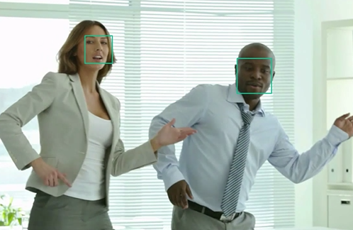
Face detection and tracking
High precision face location detection and tracking
Can detect up to 64 human faces in a video (no smaller than 24x24 pixels)
Detected and tracked faces are returned with coordinates and a Face ID to track throughout the video
Time (sec) | Face ID | x, y | Width, height
0 | 0 | 0.59, 0.23 | 0.09, 0.16
0 | 1 | 0.38, 0.15 | 0.07, 0.12
1 | 0 | 0.54, 0.25 | 0.09, 0.15
1 | 1 | 0.23, 0.18 | 0.07, 0.12

Slide 36
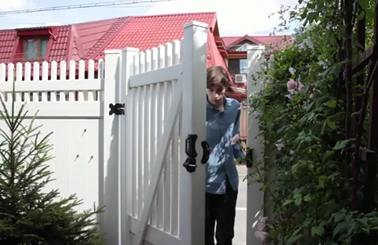
Motion detection
Indicates when motion occurs against a fixed background (e.g., surveillance video)
Trained to reduce false alarms, such as lighting and shadow changes
Current limitations:
No support for night-vision videos
Semi-transparent and small objects are not detected well
Start time | End time | In region
1.9 | 3.6 | 0
5.2 | 15.1 | 0

Slide 37
Speech
Hear and speak to your users by filtering noise, identifying speakers, and understanding intent
Bing Speech API
Speaker Recognition API
Custom Recognition Intelligent Service
Convert speech to text and back again, and understand its intent
Give your app the ability to know who's talking
Fine-tune speech recognition for anyone, anywhere
Notes:
Speech APIs provide state-of-the-art algorithms to process spoken language powered by Bing. This also includes speech synthesis for a subset of languages supported by speech recognition. With these APIs developers can easily include the ability to add speech driven actions into their applications. In certain cases, the APIs allow for real-time interaction with the user as well. Additional capabilities include voice recognition and speaker identification as well as providing partial transcription, meaning that for supported languages the developer can get partial results before the user has finished speaking. The initial release supports 7 languages.
Bing Speech API: At the time of publication, this data was not available. Please email Rebecca Duffy, reduffy@microsoft.com, if you would like more information.
We also have SDKs available for Speech.
CRIS: The Custom Recognition Intelligent Service (CRIS) enables you to create customized language models and acoustic models tailored to your application and your users. By uploading speech and/or text data to CRIS that reflects your application and your users, you can create custom models that can be used in conjunction with Microsoft’s existing state-of-the-art speech models. To customize the acoustic model to a particular domain, a collection of speech data is required. This collection consists of a set of audio files of speech data, and a text file of transcriptions of each audio file. The audio data should be representative of the scenario in which you would like to use the recognizer. If you were building an app to search MSDN by voice, it’s likely that terms like “object-oriented” or “namespace” or “dot net” will appear more frequently than in typical voice applications. Customizing the language model will enable the system to learn this. CRIS uses acoustic or language model adaptation to enable the speech recognizer to learn the characteristics of the customer’s data while still getting the benefits of all the data and expertise that went into creating the base models that power the Speech API.
For acoustic model adaptation, the technology is described in this paper: http://research.microsoft.com/pubs/194346/0007893.pdf
Works well when the data is uploaded to CRIS is truly representative of the user population and the expected usage of the application. For language model adaptation, it works best when the data uploaded reflects what people would actually say. Uploading simply a list of new terms is better than nothing but will not be as effective. For acoustic model adaptation, if you want to adapt to elderly speech, you need to upload the speech from many different elderly users, not just one or two. If you upload just one person’s voice, CRIS will learn to do a great job on that voice but will not necessarily learn to generalize to other elderly voices. Similarly, if you want to adapt to a new environment, like a factory, you should upload speech data from many speakers in the factory, not just one.
Speaker Recognition API: Microsoft's state-of-the-art cloud-based speaker recognition algorithms to recognize a human's voice in audio streams. It comprises two components: speaker verification and speaker identification. Speaker Verification can automatically verify and authenticate users from their voice or speech. It is tightly related to authentication scenarios and is often associated with a pass phrase. Hence, we opt for text-dependent approach, which means speakers need to choose a specific pass phrase to use during both enrollment and verification phases. Speaker Identification can automatically identify the person speaking in an audio file given a group of prospective speakers. The input audio is paired against the provided group of speakers, and in case there is a match found, the speaker’s identity is returned. It is text-independent, which means that there are no restrictions on what the speaker says during the enrollment and recognition phases. A use case is biometric authentication using voice.
https://blogs.technet.microsoft.com/machinelearning/2015/12/14/now-available-speaker-video-apis-from-microsoft-project-oxford/
We also have SDKs available for Speaker Reco

Slide 38

Speech APIs
Voice recognition (speech to text) Converts spoken audio to text
Voice output (text to speech) Synthesize audio from text
Speech intent recognition Convert spoken audio to intent
Notes:
Convert audio to text, understand intent, and convert text back to speech for natural responsiveness.
Speech Intent Recognition can, in addition to returning recognized text from audio inputs, also return structured information about the speech to apps that parse the intent of the speaker and drive further actions by the app. Models trained by LUIS service are used to generate the intent.

Slide 39




Speech
Language
Process text and learn how to recognize what users want
Bing Spell Check API
Web Language Model API
Linguistic Analysis API
Language Understanding Intelligent Service
Text Analytics API
Detect and correct spelling mistakes within your app
Leverage the power of language models trained on web-scale data
Easily parse complex text with language analysis
Teach your apps to understand commands from your users
Detect sentiment, key phrases, topics, and language from your text
Notes:
Bing Spell Check API: Microsoft’s state-of-the-art cloud-based spelling algorithms to detect a wide variety of spelling errors and provide accurate suggestions. Using Bing Spell Check, your mobile and PC apps will be powered with state-of-the-art spelling capabilities. Our service is trained on a massive corpus of data gleaned from billions of web pages. There is no need to train your own models. The speller model is updated regularly and incorporates new terms and brands almost as quickly as they appear on the web. This API is available through Microsoft Cognitive Services for customers with low-volume and high-latency jobs. For high-volume and low-latency we have an internal API which may be more suitable. Contact donaldbr directly for more information.
Use cases: 1) Improve the quality of a website's product search 2) provide spell correction for a keyboard app 3) provide spell correction for text fields in an app or web page 4) detect errors in UI text and user data. See https://blogs.msdn.microsoft.com/msr_er/2010/12/15/building-a-better-speller-bing-and-microsoft-research-offer-prizes-for-best-search-engine-spelling-alteration-services/ The speller is exceptional at common spelling errors with low edit-distance (such as febuary->February) but a lot of other spellers are good at that as well. We Do a very good job with word breaking, proper names in context (try "director stephen spielberg") and fictional character names, just a few examples. Areas that are a challenge are capitalization (we don't know what to do with "March" for example, even with context) and consistency (there are times when we will flag a word only intermittently based on the context).
Web Language Model API: Web Language API indexes the web and Bing queries to allow users to calculate the probabilities of natural language expressions and estimate a list of most likely words to follow an existing sequence of words. Use this API to insert spaces into a string of words without spaces, like a hashtag or URL. Use this API to rerank machine translation/speech recognition candidate sentences based on probability of the sentence.
Use this API for academic research. http://research.microsoft.com/apps/pubs/default.aspx?id=130762
We also have SDKs available for WebLM
Linguistic Analysis API: The Linguistic Analysis API helps you gain insights from text. Given a natural language parse, it’s easy to identify the concepts and entities (noun phrases), actions (verbs and verb phrases), descriptive words, and more. The processed text can provide useful features for classification tasks such as sentiment analysis.
We also have SDKs available for Linguistic Analysis.
LUIS: Language Understanding Intelligent Service (LUIS) allows developers to build a model that understands natural language and commands tailored to their application. Example: You can say “turn down the thermostat in the living room,” send it to a LUIS model, and instead of just returning the text that represents what was said, LUIS will return: the action is “turn down,” the location is “living room,” and the target is “thermostat.” LUIS allows developers to iteratively build on these models and take speech or text input and return a structured representation of what the person said. Not only that but by build LUIS will help developers create and train smart conversational bot (Intercom or Slack) with a single button. LUIS will also offer action fulfillment capabilities by simple integration with webhooks. LUIS works pretty well it comes to intents. For the entities, the learning curve is slower especially when the number of entities increases. LUIS only supports 20 intents & 10 entities yet by build each entities can have up to 10 children.
Text Analytics API: At the time of publication, this data was not available. Please email Rebecca Duffy, reduffy@microsoft.com, if you would like more information.

Slide 40
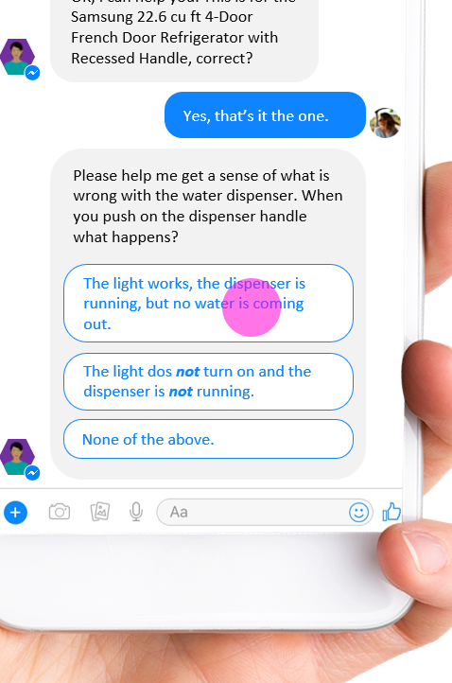
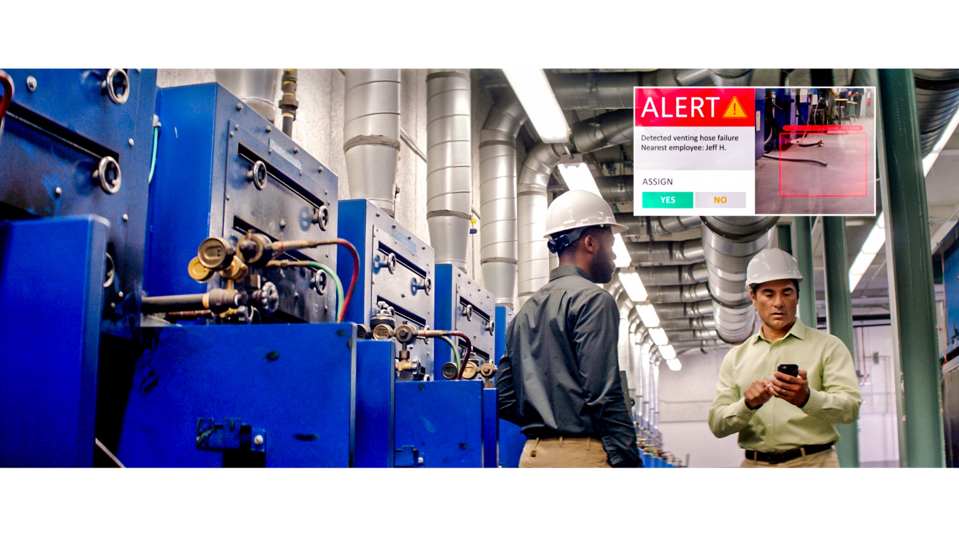
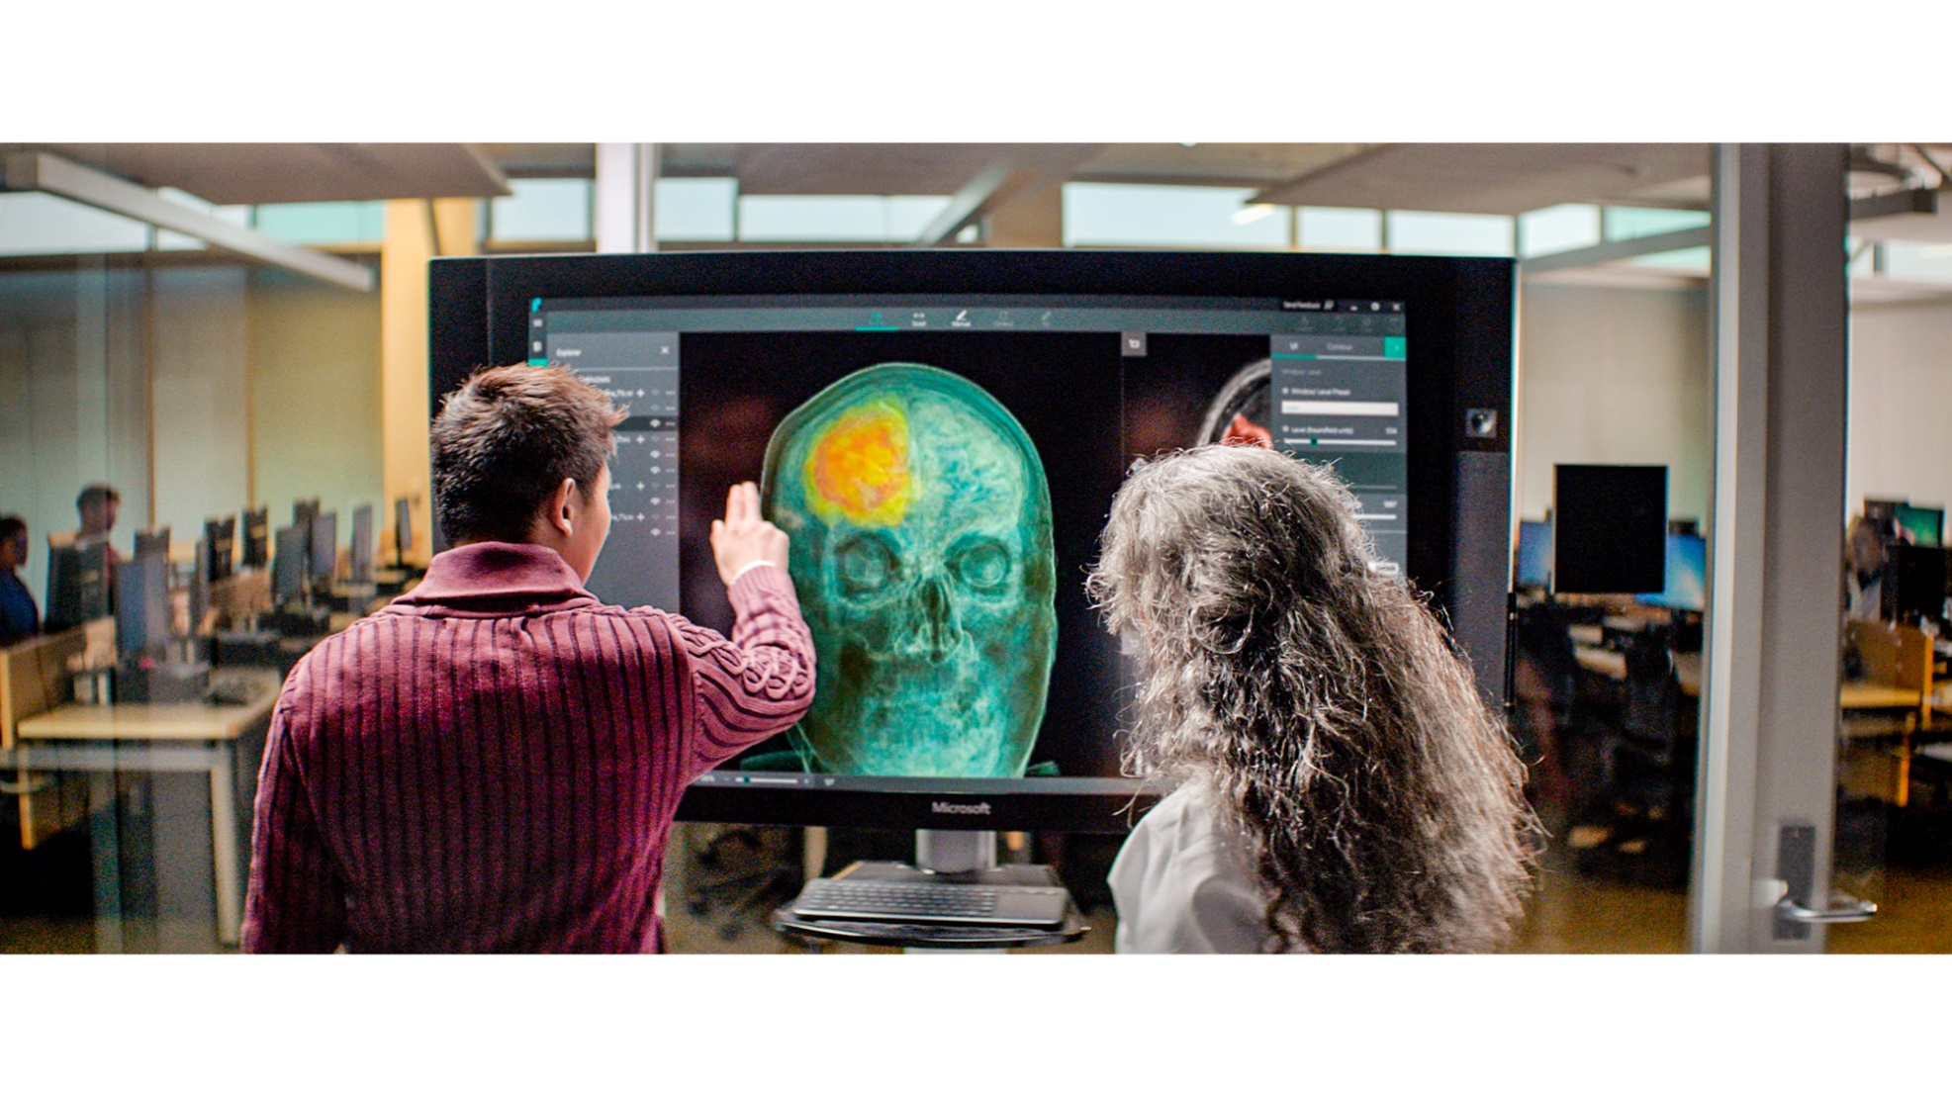


ML/AI is core component of many applications
New generation of business agents
B2B, B2C, B2E
Person, object, and activity detection
Retail, manufacturing, security
AI assisted professionals
Marketing, legal, financial
Knowledge mining
Documents, video
Autonomous systems
Vehicles, networks, RPA

Slide 41
Azure ML Services
Solutions for every possible requirement

Slide 42





Slide 43


























Advanced analytics pattern in Azure
Data collection and understanding, modeling, and deployment
Model training
Serving storage
Sensors and IoT (unstructured)
Azure ML service
Azure ML Studio
ML server
Azure Databricks (Spark ML)
SQL Server (in-database ML)
Data Science VM
Batch AI
Applications
Cosmos DB
Long-term storage
Data processing
Logs, files, and media (unstructured)
SQL DB
Azure Data Lake store
Azure Storage
Cosmos DB
SQL DB
Azure Data Lake Analytics
Azure Databricks
HDInsight
Orchestration
Trained model hosting
SQL DW
Business/custom apps (structured)
Power BI Dashboards
Azure Container Service
SQL Server (in-database ML)
Azure Analysis Services
Azure Data Factory
© Microsoft Corporation

Slide 44
More People Building Machine Learning Models
ML Expert
AML SDK /
Notebooks
No Code
Code First
Auto ML (UX+SDK)
Power BI
No ML

Slide 45

Challenges
Setup development environment
Not familiar with syntax
Manage hardware & infrastructure
Manage scale (training and inference)
Lack of flexibility
Integration with production environment

Slide 46

More People Building Machine Learning Models
ML Expert
AML SDK /
Notebooks
Azure Machine Learning service Visual Interface
No Code
Code First
Auto ML (UX+SDK)
Power BI
No ML

Slide 47
Azure Machine Learning Studio

Slide 48





Azure machine learning studio
A fully-managed cloud service that enables you to easily build, deploy and share predictive analytics solutions
Use Azure Machine Learning to deploy your model into production as a web service in minutes
Work with familiar coding languages such as R and Python while benefitting from hundreds of built-in packages and support for custom code
Deploy models to production as web services that can be called from any device, anywhere, using any data source
Easily share your solution with the world on the Azure Marketplace
© Microsoft Corporation

Slide 49
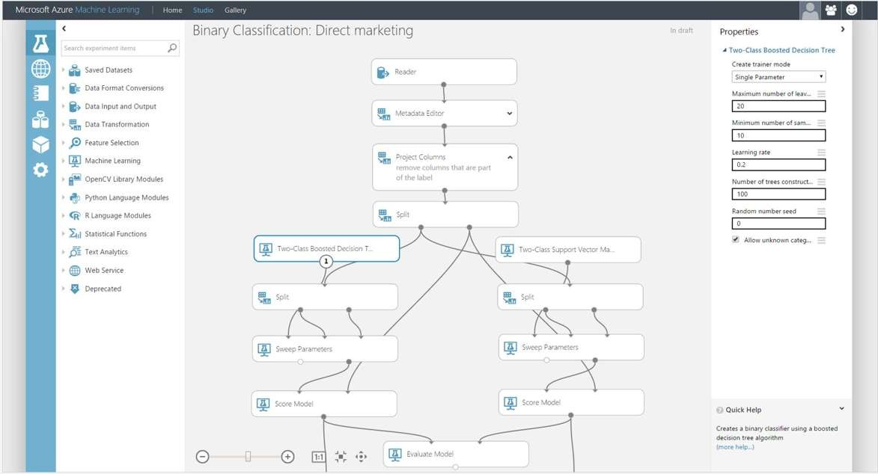
AZURE MACHINE LEARNING STUDIO
Platform for emerging data scientists to graphically build and deploy experiments
Rapid experiment composition
> 100 easily configured modules
for data prep, training, evaluation
Extensibility through R & Python
Serverless training and deployment
Some numbers:
100’s of thousands of deployed models serving billions of requests

Slide 50
What is Machine Learning?

Slide 51





Machine Learning
Machine learning is the subfield of computer science that gives “computers the ability to learn without being explicitly programmed“.

Slide 52
Creating Azure ML Account
Notes:
For a recorded presentation by Azure IoT Program Management through C+E University: IoT Online webinar series: please visit:
https://mspartnerlp.partner.microsoft.com/LearningPath/LearningPath/DLPaths?trackId=2918&rowId=3606&trackPathId=14612

Slide 53
Workflow of Azure ML project/experiment
Notes:
For a recorded presentation by Azure IoT Program Management through C+E University: IoT Online webinar series: please visit:
https://mspartnerlp.partner.microsoft.com/LearningPath/LearningPath/DLPaths?trackId=2918&rowId=3606&trackPathId=14612

Slide 54
Workflow of Azure ML
GET THE DATA
PREPARE THE DATA
FEATURE SELECTION
CHOOSE AND APPLY LEARNING ALGORITHMS
TRAIN AND EVALUATE THE MODEL

Slide 55
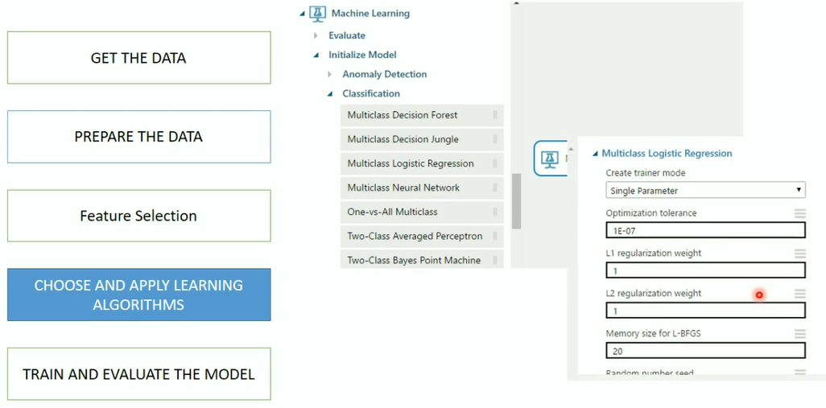
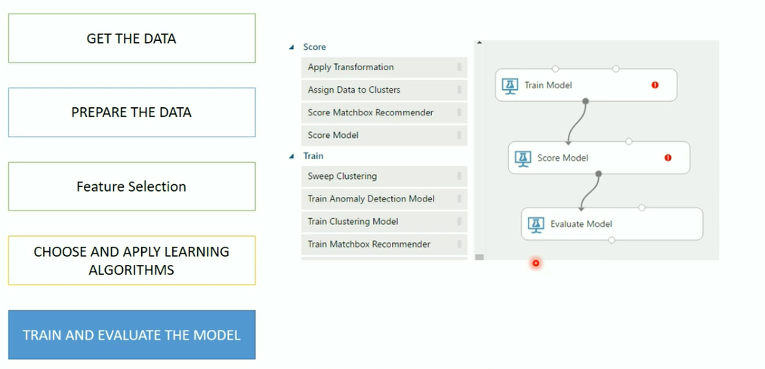
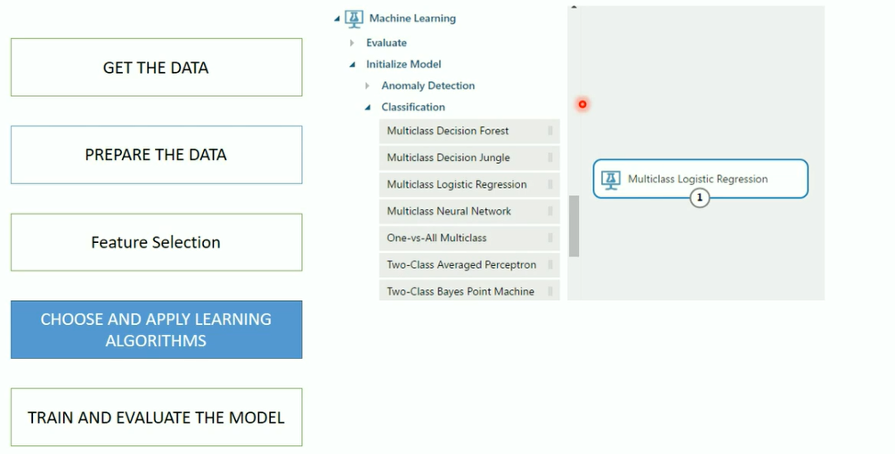
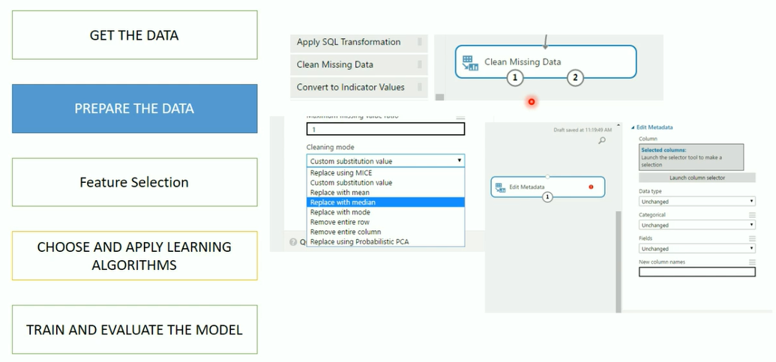
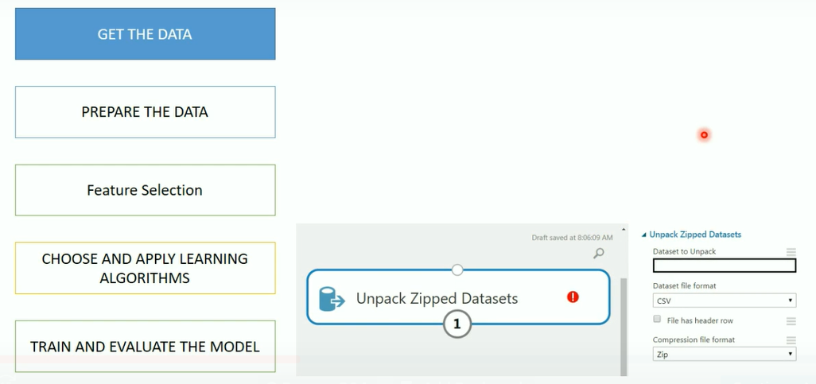
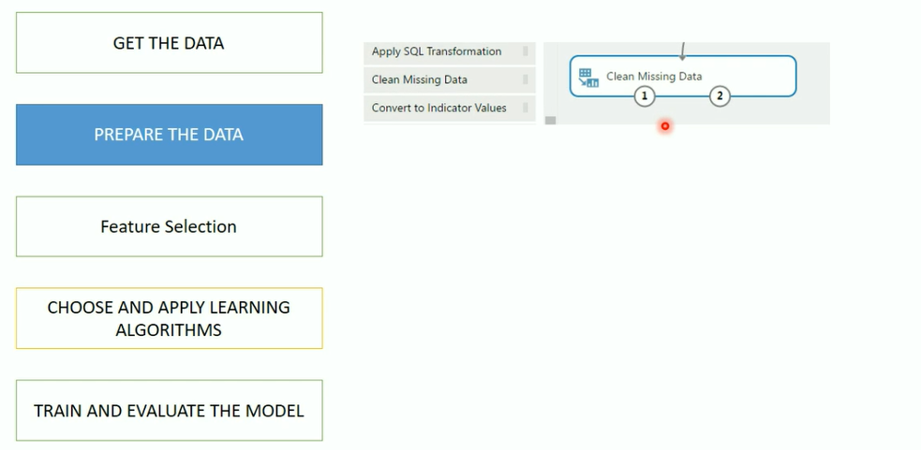
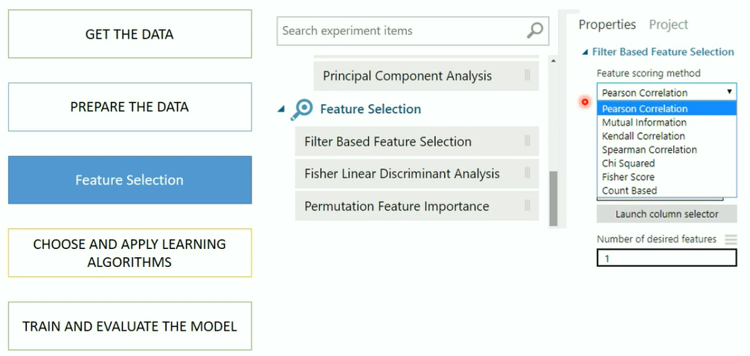
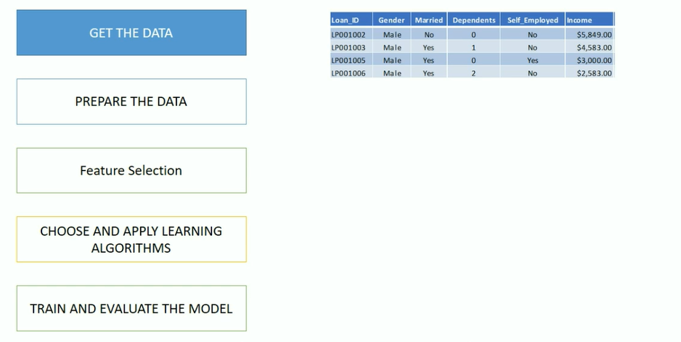
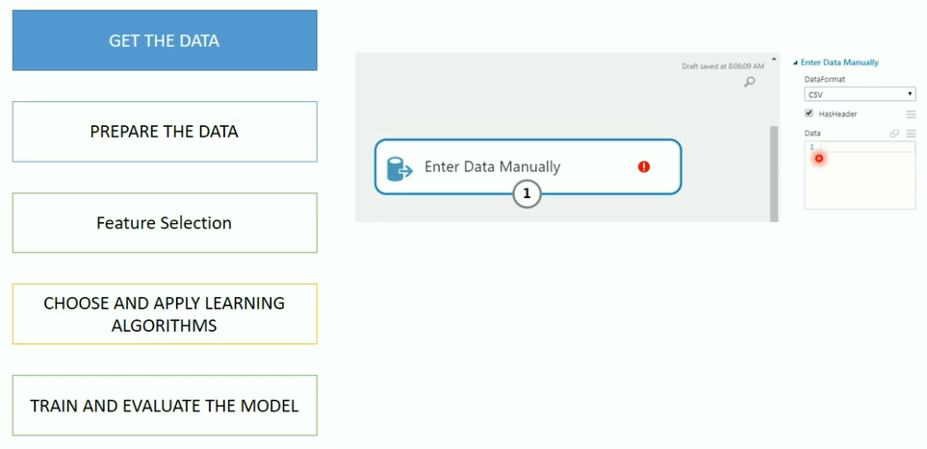
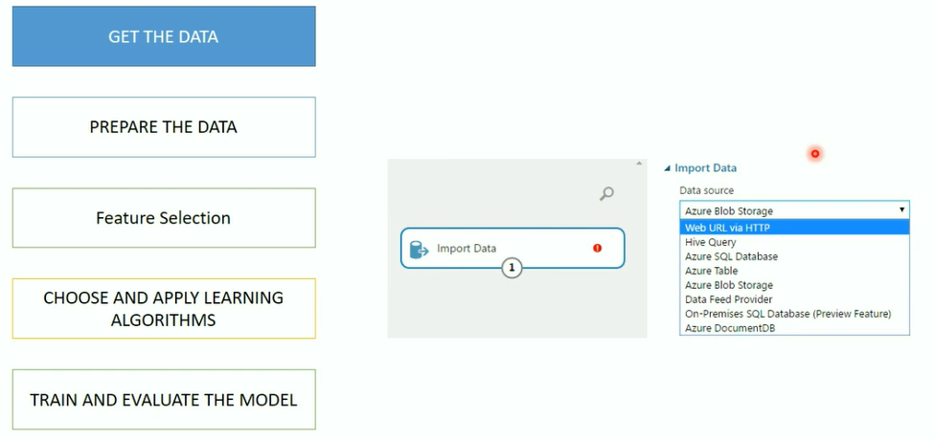
Workflow of Azure ML

Slide 56
Azure ML Algorithm CheatSheet
Notes:
For a recorded presentation by Azure IoT Program Management through C+E University: IoT Online webinar series: please visit:
https://mspartnerlp.partner.microsoft.com/LearningPath/LearningPath/DLPaths?trackId=2918&rowId=3606&trackPathId=14612

Slide 57
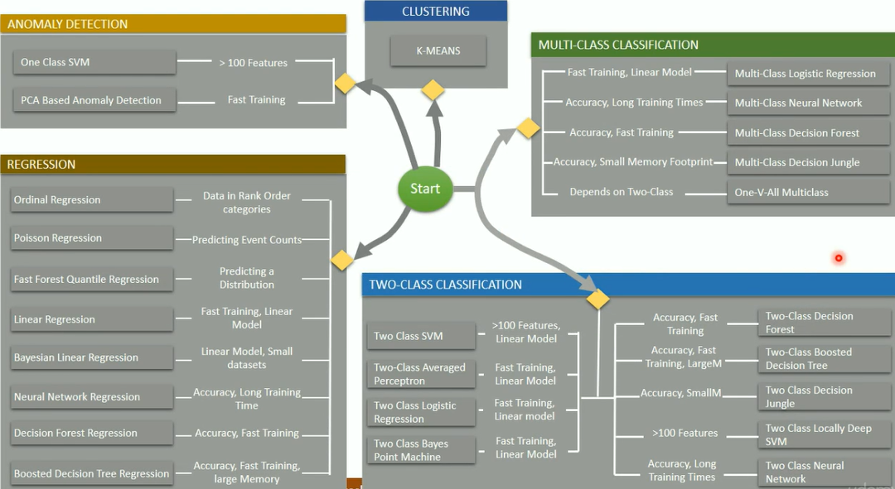

Slide 58
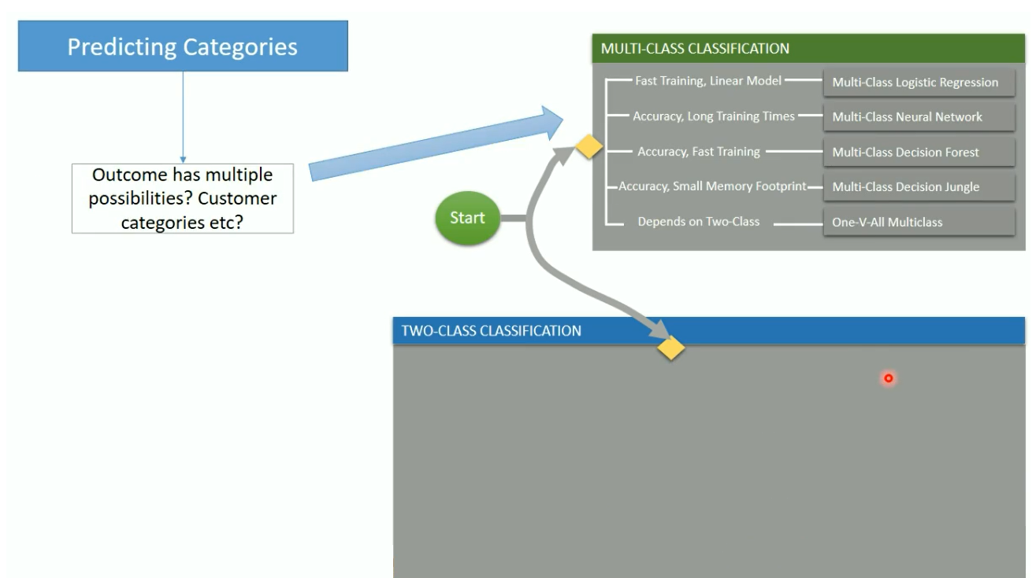
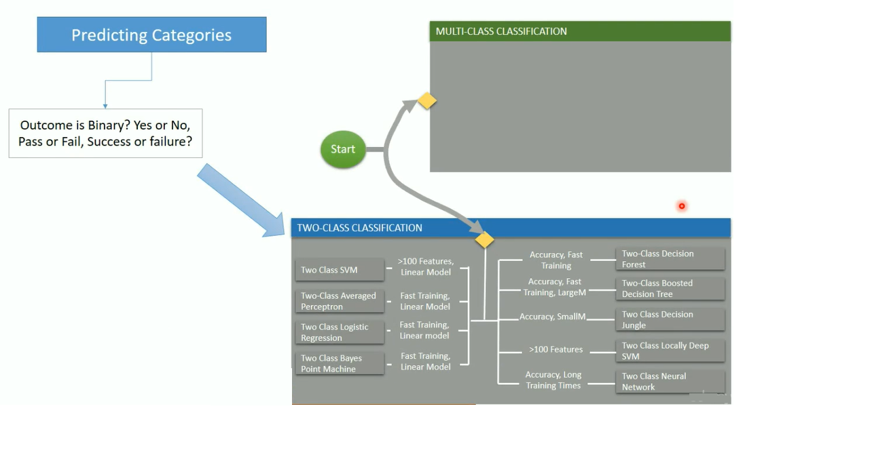

Slide 59
Hands on

Slide 60
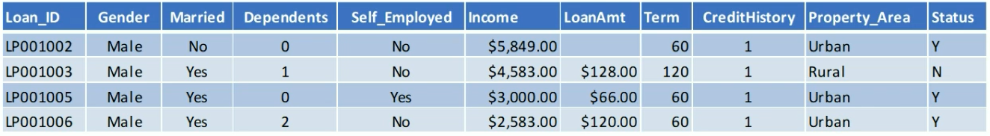
Problem Statement
Automate loan eligibility process
Identify customers whose loan will be approved

Slide 61
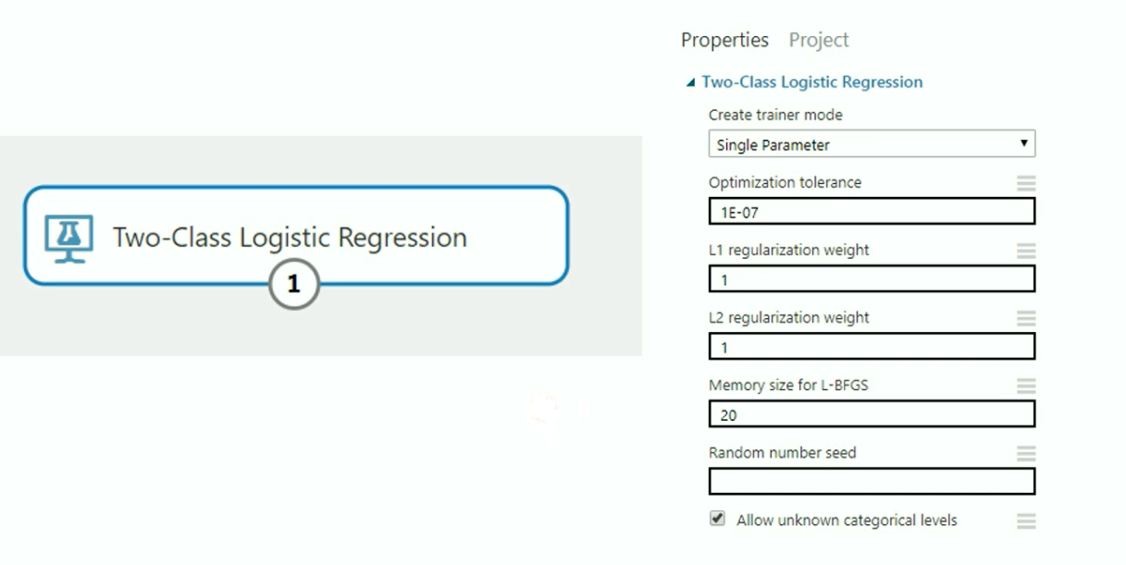
Logistic Regression in Azure ML

Slide 62
What is Logistics Regression?
Used to predict the probability of an outcome
Can be binary - Yes/No or Multiple
Supervised learning method
Must provide a dataset that already contains the outcomes to train the model.

Slide 63
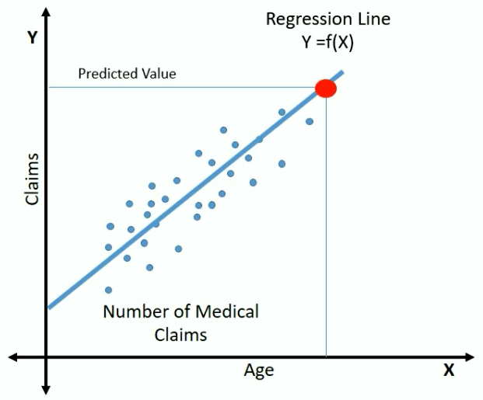
Understanding the Logistic Regression
Y = f(x)
Y = b0 + b1X
No of claims = 18 + b1(age)
Simple Linear Regression

Slide 64
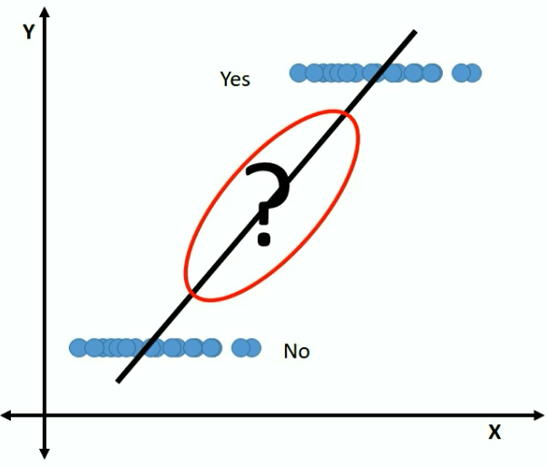
Logistic Regression?
Outcome is categorical
What is the probability of this customer buying
this product?

Slide 65
Logistic Regression?
Probability needs to satisfy two basic conditions
• Always positive i.e. > 0
• Always less than or equal to 1
To make it positive
Y = b0 + b1 X exp(Y) = exp (b0+ b1X)
To make it less than 1 divide it with a number greater than P

Slide 66
Logistic Regression?
exp(Y) = exp ( b0 + b1X)
------------- -------------------
exp(Y) + 1 exp ( b0 + b1X) + 1
e^y
P = ------------- probability of success
e^(y) + 1

Slide 67
Logistic Regression?
e^y
P = ------------- probability of success
e^(y) + 1
e^y e^(y) + 1 – e^y 1
Q = 1 – P = 1 - ----------- = --------------------- = ----------
e^(y) + 1 e^(y)+1 e^(y) +1
Probability of Failure

Slide 68
Logistic Regression?
P
--------- = e^Y
1 – P
P
Log --------- = Y
1 – P
P
Log --------- = b0 + b1X
1 – P

Slide 69
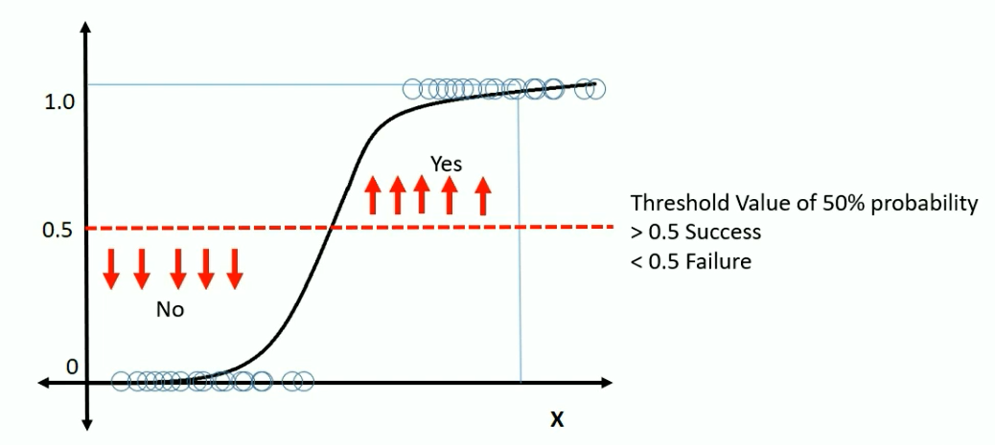
Plotting Logistic Regression?
P
Log --------- = b0 + b1X
1 – P

Slide 70

What are Hyperparameters?

Slide 71
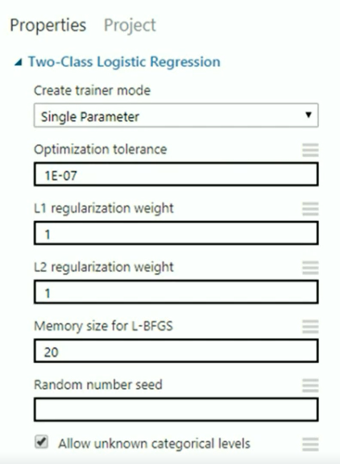
Parameters to Logistic Regression
Create Trainer Mode
• Single Parameter - Provide specific set of values
• Parameter Range - specify multiple values and get the optimum set for given configuration
Optimization Tolerance - Threshold Value to stop the model iterations on trained dataset
Memory Size for L-BFGS - Amount of memory to use for next steps and direction
Random Number Seed - Random integer number that is used for reproducing the same results
Allow Unknown Categorical Levels - Creates an additional "Unknown" level

Slide 72
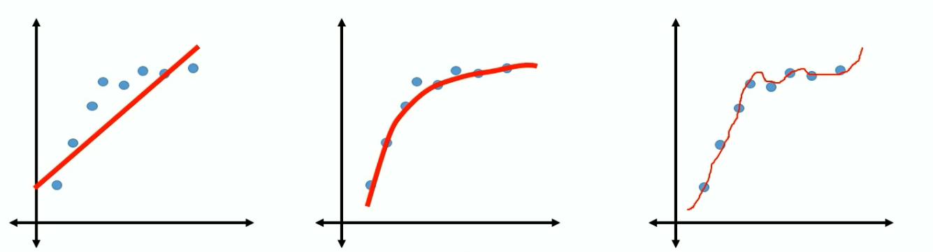
Regularization Weight
b0 + b1X b0 + b1X1 ² b0 + b1X1 ² + b2X2³
Under-fit Right Over Fit
What if the effect of such weights is reduced significantly
Or reduced to zero

Slide 73
Regularization Weight
L2 (Ridge) shrinks all the coefficient by the same proportions but eliminates none
L1(Lasso) can shrink some coefficients to zero, performing variable selection.
Both L1 and L2 regularization prevents overfitting by shrinking (imposing a penalty) on the coefficients.
L2 penalizes one big weight more than many small weights.
With L2, you tend to end up with many small weights, while with L1, you tend to end up with larger weights, but more zeros.

Slide 74
Hands on – Hyper Tuning

Slide 75
What is a Decision Tree?

Slide 76
What is Decision Tree?
Supervised learning method
Decision support tool that uses a tree-like graph or model of decisions and their possible consequences
Various variations such as Boosted Decision Tree, Decision Forest, Decision Jungle
Can be used for categorical as well as continuous variables

Slide 77
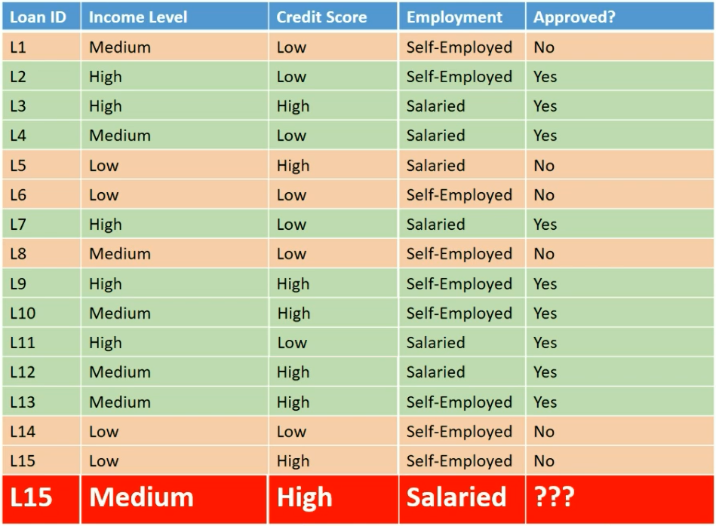

Slide 78
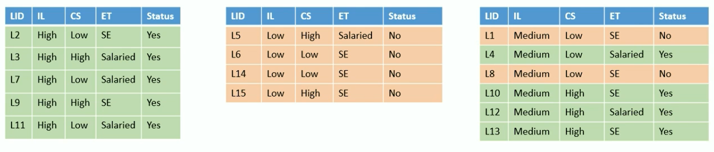
Income
Level
HIGH
LOW
Medium
Pure Subset Pure Subset Split Further

Slide 79
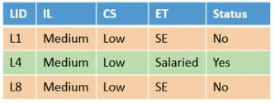
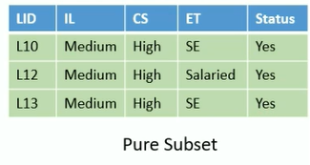
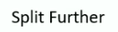
Income
Level
HIGH
LOW
Medium
Credit Score
LOW
HIGH

Slide 80
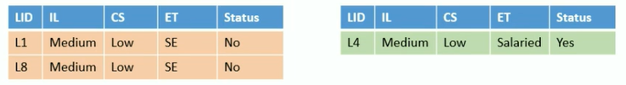
Income
Level
HIGH
LOW
Medium
Credit Score
LOW
HIGH
Employment Type
SE
Salaried
Pure Subset Pure Subset

Slide 81
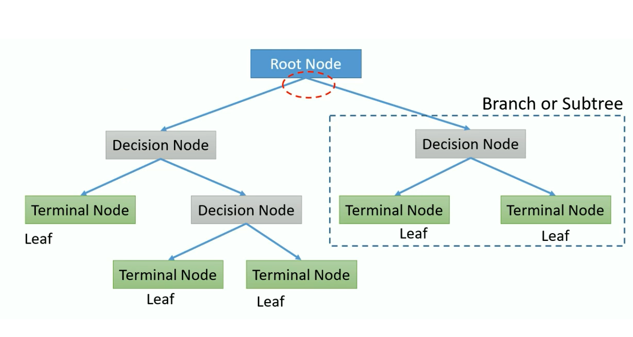
Decision Tree Terms

Slide 82
Ensemble learning

Slide 83
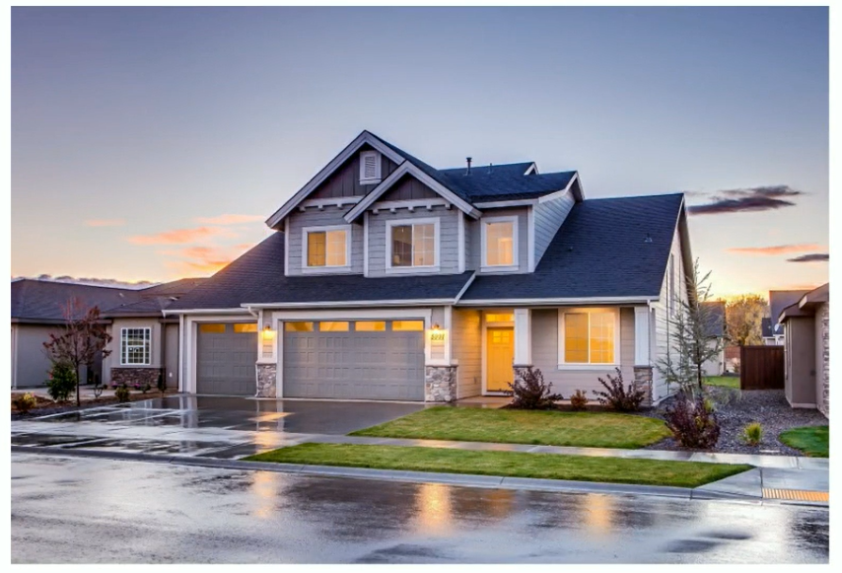
Everyday Ensemble Learning

Slide 84

Decision?

Slide 85

Decision?
Broker or real estate portal to check
fair price, price appreciation
Friend or colleague who stays nearby
or stayed in the neighbourhood
Inspection by an architect for quality
checks and structural defects.

Slide 86



Decision?
Is this price fair?
Appreciation of price?
Construction Quality?
Location appropriate?
Neighbourhood?

Slide 87
Ensemble Learning
All algorithms have errors
Collective wisdom is higher than the individual intelligence
Generate a group of base learners and combined result gives higher accuracy
Different base learners can use different,
Parameters
• Sequence
Training sets etc
Two major Ensemble Learning Methods
• Bagging
• Boosting

Slide 88


Bagging
Various models are built in parallel
All models vote to give the final prediction

Slide 89
Boosting
Train the Decision Tree in a sequence
Learn from the previous tree by focussing on incorrect observations
Build new model with higher weight for incorrect
observations from previous sequence

Slide 90
Bagging
Various models are built in parallel
All models vote to give the final prediction

Slide 91

Bagging

Slide 92

Adult Census Data
Problem statement: Predict whether income exceeds $50K/yr based on census data
1. Age
2.Workclass
3.Fnlwgt
4.Education
5.Education-Num
6.Marital Status
7. Occupation
8.Relationship
9. Race
10. Sex
11. Capital Gains
12. Capital Losses
13. Hours per week
14. Native Country
15. Income

Slide 93
Hands on – Decision Trees & Deployment

Slide 94
Tune Model Hyperparameters

Slide 95
What are Hyperparameters?

Slide 96
Model parameters?
Decision Trees
Maximum number of leaves per tree
Minimum number of samples per leaf node
Learning rate
Number of trees to construct
Logistic regression
Optimization tolerance
L1 regularization weight
L2 regularization weight
Memory size for L-BFGS

Slide 97
Tune Model Hyperparameters?
Helps in determining the best possible combination of hyperparameters
Also known as hyperparameter optimization
Performance metric to measure
Accuracy
Precision
Recall
AUC
F1Score

Slide 98
Parameter Sweeping Modes
Random Grid
Entire Grid
Random Sweep

Slide 99

What is a Grid?
Cartesian Product of Parameters
Parameter 1→ 1, 2, 3
Parameter 2→ A, B, C, D

Slide 100


Random Grid

Slide 101

Entire Grid

Slide 102
DEMOS

Slide 103
Deploy Models

Slide 104
I have a Model. Now What?
Develop but how to deploy?
Model language is not supported
Difficult to deploy in the current architecture
Tedious Environment set-up
Many more...

Slide 105
Steps for Azure ML webservices Deployment
Creating a Training Experiment
Convert to predictive experiment
Deploy it as a web-service
Consume the web-service

Slide 106
Regression

Slide 107

Regression Analysis
Statistical process for estimating the
relationships among variables
Relationship between a dependent
variable and one or more independent
variables (or 'predictors’)
The predictor is a continuous variable
Can also be used to infer causal
relationships between dependent and
independent variables.

Slide 108

Casual Relationship?

Slide 109


Slide 110
Linear Regression
Simple Regression
Y= B0 + B1X
Multivariate linear regression.
Y= B0 + B1X1 +B2X2 + B3X3……..BnXn

Slide 111
Simple Linear Regression

Slide 112

Simple Linear Regression
Simple Regression
Y = b0 + b1X
Dependent Variable Independent Variable

Slide 113



Simple Linear Regression

Slide 114



Simple Linear Regression

Slide 115

https://gallery.azure.ai/

Slide 116
Data Science Virtual Machines (DSVM)

Slide 117


Data Science Virtual Machines

Slide 118



Slide 119


Slide 120




Why Data Science VMs?
Elastic analytics desktop in the cloud
Get started quickly on Azure Machine Learning
Pre-setup environment at work and school
Enterprise Ready and globally available

Slide 121



Productive Services Empower data science and development teams
Integrated data science & data engineering teams
Desktop solutions not adequate
Need a unified big data & machine learning solution
Individual data scientists
Desktop solutions adequate
Need cloud for sporadic compute needs
+
Azure Databricks
Azure Machine Learning service
Machine Learning VMs
Notes:
We realize that companies are at different stages of building data science teams.
From a sales perspective, we would like you to focus on companies that are building end to end big data and machine learning solutions as this where you will drive maximum amount of Azure consumption.
For these customers, we recommend starting with Azure Databricks and enhancing the ML experience with Azure Machine Learning.
Now we also realize that a good number of projects that are not done on big data or by big integrated teams.
For these customers, we have a set of Machine Learning VMs that are pre-provisioned with popular open source tools and packages. These are essentially desktops in the cloud that enable data scientists to quickly get up and running for their projects.
Let’s look at how we use Azure Databricks and Azure ML together.

Slide 122
Azure Machine Learning service

Slide 123
WHAT IS AZURE MACHINE LEARNING SERVICE?
Set of Azure Cloud
Services
Python SDK
That enables you to:
Prepare Data
Build Models
Train Models
Manage Models
Track Experiments
Deploy Models

Slide 124










Custom AI
Typical E2E Process
Prepare
Experiment
Operationalize/Deploy
…
Data Science Virtual Machine Azure Databricks
Machine Learning Compute
Azure Container Instances Azure Kubernetes Service
Azure Data Factory
Azure Databricks
Azure ML service
Orchestrate

Slide 125

Azure ML Concept
Model Management
Model Management in Azure ML usually involves these four steps
Step 1:
Step 2:
Step 3:
Step 4:

Slide 126
Azure ML Artifact
Compute Target
Currently supported compute targets
Compute Target | Training | Deployment
Local Computer | ✓
A Linux VM in Azure (such as the Data Science Virtual Machine) | ✓
Azure ML Compute | ✓
Azure Databricks | ✓
Azure Data Lake Analytics | ✓
Apache Spark for HDInsight | ✓
Azure Container Instance |  | ✓
Azure Kubernetes Service |  | ✓
Azure IoT Edge |  | ✓
Field-programmable gate array (FPGA) |  | ✓

Slide 127





Azure ML Artifact
Deployment
Deployment is an instantiation of an image. Two options:
Web service
IoT Module

Slide 128

Services
Customer journey
Data Prep
Build and Train
Manage and Deploy
Python ML developer
Azure ML service
(OSS frameworks, Hyperdrive, Pipelines, Automated ML, Model Registry)
Azure ML service
(containerize, deploy, inference and monitor)
Azure ML service
(Pandas, NumPy etc. on AML Compute)
+
Apache Spark / Big Data
Azure Databricks
(Apache Spark Dataframes, Datasets, Delta, etc.)
Azure Databricks + Azure ML service
(Spark MLib and OSS frameworks +
Automated ML, Model Registry)
Azure ML service
(containerize, deploy, inference and monitor)

Slide 129
Comparable Table
 | Azure Machine Learning Studio | Azure Machine Learning Services
Pros | Rapid development (Drag and Drop) Works well with relatively simple datasets Pre-built ML algorithms Cheap | Fast (VMs with GPUs) Different optimization methods, CI/CD pipeline Full control during training Manage computing resources (choose VM size) Use open source ML libraries
Cons | Can be slow Limited optimization methods, operationalized architecture Less control during training Fixed computing resources | More elaborate to build, require deeper knowledge of machine learning Deeper models need much more data with much more memory Higher costs for VM with GPU

Slide 130
Demo –Deployment

Slide 131
Demo – Hyper Tuning Parameters

Slide 132
Automated Machine Learning
(in Machine Learning Services)

Slide 133


What is automated machine learning?

Slide 134

AutoML
© Microsoft Corporation

Slide 135


Machine Learning Process
SQL DB
Cosmos DB
Datawarehouse
Data lake
Blob storage
…
Prepare Data
Build & Train
Deploy

Slide 136
Machine Learning Problem Example
How much is this car worth?

Slide 137
Model Creation Is Typically Time-Consuming
Which features?
Which algorithm?
Which parameters?
Mileage
Condition
Car brand
Year of make
Regulations
…
Gradient Boosted
Nearest Neighbors
SVM
Bayesian Regression
LGBM
…
Parameter 1
Parameter 2
Parameter 3
Parameter 4
…
Mileage
Gradient Boosted
Condition
Nearest Neighbors
Car brand
Car brand
50%
Year of make
30%
Year of make
Model
Iterate

Slide 138

Machine Learning Complexity
Source: http://scikit-learn.org/stable/tutorial/machine_learning_map/index.html

Slide 139

Model Selection & Hyperparameter Tuning
Dataset
Model Training
Infrastructure
Training Algorithm 1
Training Algorithm 2
Model 1
Model 2
Model 3
Model 4
Hyperparameter
Values – config 1
Hyperparameter
Values – config 2
Hyperparameter
Values – config 3
Repetitive & Manual
Hyperparameter
Values – config 4

Slide 140
Introducing Automated Machine Learning
Dataset
Optimization
Metric
Automated ML
ML Model
Constraints
(Time/Cost)
Accessible & Faster

Slide 141

Automated ML Capabilities
Based on Microsoft Research
Brain trained with several million experiments
Collaborative filtering and Bayesian optimization
Privacy preserving: No need to “see” the data

Slide 142
Automated ML Capabilities
ML Scenarios: Classification & Regression
Integration: Azure Machine Learning, Azure Notebooks, Jupyter Notebooks
Data Type: Numeric, Text
Languages: Python SDK for deployment and hosting for inference
Training Compute: Local Machine, Remote Azure DSVM (Linux), Azure Batch AI
Transparency: View run history, model metrics
Scale: Faster model training using multiple cores and parallel experiments

Slide 143












Azure Automated ML
Current Capabilities
 | Category | Value
Compute Target

Slide 144
Web UI [Azure portal - Preview]
Create automated ML experiments from UI only (“no code”)
Get started with ML quickly
Powered by the automated ML SDK – easily customize advanced settings
Automate the end-to-end ML workflow from the UI
Easily explore and monitor all your experiments from a single place
Roadmap
Private Preview - 2/11
Getting started experience
Start an automated ml training job on your data (upload/Blob)
Explore data
View progress and results for training job and each iteration
View automated ML dashboard for an overview
May 2019 – General Availability
Apply data transformations
Support additional 1p & 3p data source
Continue experiment in Jupyter Notebook
Public Preview - April 2019
Set advanced settings for the training job
Forecasting support
Automatically deploy a model
Advanced data exploration (visualizations, correlations, etc.)
View model Explainability
Support additional 1p data sources (e.g. Azure SQL, ADLS, …)
Microsoft confidential (NDA)

Slide 145



“Day 0” (First time) experience
Create your first experiment with automated machine learning to produce quality models with zero effort
Automate the process of algorithm selection, hyperparameter tuning, and best model selection with automated machine learning, and accelerate your productivity. Select your data and let automated ML do the rest to provide the best model from endless possible options

Slide 146


Create a new automated machine learning experiment
* Experiment name
myfirstautomlexperiment
* Training compute 
amlcompute-4a57de20b3f1
Create new
Cancel
Next

Slide 147




Create a new automated machine learning experiment
* Experiment name
myfirstautomlexperiment
* Training compute 
Select existing…
Create new
Select a file from Azure blob storage account
* Storage account
mytestmlexperimentsto…
* Container
automl-blob-d8b2d4df-…
Select a sto ner to view the files list
rage account and a contai
Data Preview
Data Profile
Use first row as header
Include in training
Include in training
Include in training
Include in training
Include in training
Include in training
Include in training
Include in training

Slide 148



Data Preview
Data Profile
Include in training
Include in training
Include in training
Include in training
Include in training
Include in training
Include in training
Include in training
Training job settings:
* Training job type 
Classification
* Target column 
Freight cost
* Primary metric 
Accuracy
Number of iterations:
100

Slide 149


Data Preview
Data Profile
Data Preview
Data Profile
Condensed view
Include in training Include in training Include in training Include in training Include in training Include in training
Include in training Include in training
Training job settings:
* Training job type 
Classification
* Target column 
Freight cost
* Primary metric 
Accuracy
Number of iterations:
100

Slide 150


Training job settings:
* Training job type 
Classification
* Target column 
Freight cost
* Primary metric 
Accuracy
Number of iterations:
100
Cancel
Start

Slide 151





Myfirstautomlexperiment | Run #XXX

Slide 152






















“Day 30” experience
Automated machine learning dashboard
All dates
#
Running
#
Completed
Run status history (All)
15
Cancelled
10
Failed
5
Completed
#
Failed
#
Cancelled
0
Running

Slide 153
Demo

Slide 154
Build 2019

Slide 155




Authoring Experiences in Azure Machine Learning
Automated
Machine Learning
Visual Interface
Notebooks

Slide 156
Authoring Experiences in Azure Machine Learning
Automated
Machine Learning
Visual Interface
Visual Interface
Notebooks

Slide 157

Visual Interface for Azure Machine Learning service (Public Preview)
Visual workflow to build, test, and deploy ML models more easily and efficiently

Slide 158

Who to Use
New to Machine Learning
Novice Data Scientists
ML Experts
Learn machine learning
Build model and prefer visual tool than coding
Quick prototype

Slide 159

Visual Interface
Drag-n-drop
Built-in modules
Data visualization
Model evaluation

Slide 160


Best from AML service
Bring your own compute
Scale align with data growth or model complexity
Auto cool down for saving cost
Deploy to your own environment
Run history & versioning
Debuggability

Slide 161




Fully Integrated with AML Service
Computes
Experiments
Models
Web Services
Visual Interface

Slide 162




Fully Integrated with AML Service
Computes
Experiments
Models
Web Services
AML Service on Azure Portal

Slide 163

Easy Deployment
A few clicks
Automatic generate scoring file
Model registration
Build image
AKS for scale

Slide 164

Custom Code
Run Python code
Create Model
Placeholder

Slide 165
Building blocks for a Data Science Project
Build and train models
Hyperparameter tuning
Experimentation and pipelines
Deployment
DevOps for data science
Classical ML
Data sources
Deep learning
Notes:
Let’s first talk about about building blocks of a Data Science Project. Agree on terminology.
Example of Classical ML algorithm
A model parameter is a configuration variable that is internal to the model and whose value can be estimated from data.
A model hyperparameter is a configuration that is external to the model and whose value cannot be estimated from data.
Experimentation and pipelines?
Deployment. What could be a deployment target?

Slide 166








Machine Learning on Azure
Domain Specific Pretrained Models
To reduce time to market
…
Vision
Speech
Language
Search
Familiar Data Science Tools
To simplify model development
PyCharm
Jupyter
Visual Studio Code
Command line
Popular Frameworks
To build machine learning and deep learning solutions
PyTorch
TensorFlow
Scikit-Learn
ONNX
Productive Services
To empower data science and development teams
Azure Databricks
Azure Machine Learning
Machine Learning VMs
Powerful Hardware
To accelerate deep learning
CPU
GPU
FPGA
From the Intelligent Cloud to the Intelligent Edge
Notes:
Distinguish between prebuilt and custom ai.

Slide 167
Power BI AutoML

Slide 168


Slide 169


